Slide 1


KOKO Settlements and Payment System
Deep Dive
26 March 2019
CONFIDENTIAL
Notes:
As promised, we wanted to give you an update on the KSPS. Just to refresh, the KSPS is separate from the KOKO Core Engine, and also separate from the Odoo ERP, it’s a self-contained module/tool that runs processes related to KOKO’s high volume commercial financial transactions and the associated accounting

Slide 2
Agenda
Project Organisation
Project Requirements
Project Evolution
Key Use Cases & Demonstrations
Settlements and Payments
Open Questions
Appendices
KSPS Performance Testing
Software Design & Architecture
Related Odoo Modules
Bank Upload File

Slide 3
Project Organisation
 | Individual / Team
Responsible | Karan Rai, Amar Jethwa (Product Owner), David Mwaura, Prolitus Tech
Accountable | Nicholas Stokes (Business Owner)
Consulted | Systems team, Finance - Accounting team + dedicated KSPS team (Humphrey and James)
Informed | Finance, Systems team, Customer and Agent Software team
Notes:
Systems team, predominantly consulted with regard to integration with KOKOCore etc / Finance team consulted for accounting & compliance related matters

Slide 4
2. Project Requirements
The team was tasked to build a system fit for the following purposes:
Deliver a scalable and robust solution to automate accounting for, and monetary flows related to, transactions involving KOKO partners (Consumers, Agents and B2B partners) on KOKO’s smart urban commerce platform
Accurately record and process a high volume of daily transactions on a real time basis in accordance with various business and tax rules
Sync up with all relevant ERP and KOKO Core Engine modules
Provide external partners to KOKO (including possibly regulators) with complete confidence in the system’s integrity and efficiency
Notes:
Scalable, stable, synced up, and a product/solution whose functions we can showcase / productise

Slide 5
3. Project Evolution
January 2018
June 2018
September 2018
November 2018
December 2018
February 2019
April 2019
May 2019
KOKO Settlements System : Inception
Kick Off - KSPS Development on Odoo ERP
Change from Franchise Fee Model to KOKOpoint Rental
Go Live - KSPS version 1
Hard Launch - Go Live
Testing Complete KSPS version 1
Business Model Change - KOKO Owns Fuel
Final Development KSPS version 2
March 2018 : Finalizing ERP Framework
May 2018 : Onboard Product Manager
July 2018: Contracted Prolitus

Slide 6
4. Key Use Cases & Demonstrations
Automated accounting for & processing of transactions involving
End Customers: top ups, stove and fuel purchase and sale
Agent Partners: Agent Economics management
Wholesale Partners: Fuel price management, fuel purchases
KRA tax compliance: VAT (ESD integration, assignment by transaction type), WHT
Payments: settlement reports and bank payment files

Slide 7
4. Key Use Cases (1/5) - Overview
Customers
Agents
KOKO Internal and Tax
Wholesaler (eg: VIVO)
Registration
Commissions
Real time tax computation (VAT, WHT)
Fuel supply to KOKO /Agent network
Top up
Rent management
Real time financial accounting & liquidity management
Stove purchase
Floor earnings
Fuel purchase
Credit transfers
Referral bonuses
Accounting
Automated Settlements and Payments
Notes:
High volume financial transactions over the network is captured automatically as the correct Journal entries in the accounting system.
Example transactions: Top ups, Fuel purchase, KP refuel, Stove purchases.
The network technology infrastructure interfaces with the Accounting platform (Odoo) which is customised to accurately capture these transactions, while maintaining system integrity in real time.
Key decisions:
Separation of objects between KOKO Core and Odoo (Wallet balances, Product pricing - stove and fuel)
Consistency of information across system in real time - What if a customer buys fuel while his previous transaction is still not recorded or failed to record.
Accurate Journal entries and accounting of VAT
Business value delivered:
To perform this accounting without an ERP system would have required a team over over 50 accountants to manually log these entries and it would still be prone to errors
16 accountants to only capture Top ups and Fuel purchases at 200,000 customers buying and topping up 2 times a week, i.e $192,000 per year @ $1000 per accountant.

Slide 8
4. Key Use Cases (2/5) - Customer Top Up
KOKO Core
Odoo
Jobs
Customer Top Up
Account for Top up
Manage VAT based on
Stove vs Non Stove user
Wallet balance ++
Journal entries ++
Notes:
Handover to Amar and David:
Amar - Customer Top Up
Amar - Credit Transfer
David - Stove Order and Fulfillment

Slide 9
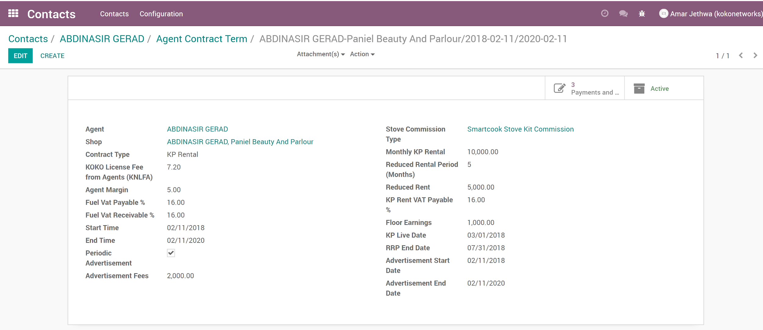
4. Key Use Cases (3/5) - Agent Economics Management
KOKO Core
Odoo
KOKO Cooker sale
KDM fees
Account for Agent
Commissions
Calculate commissions
Based on Contracted terms
KOKO Fuel sale
Rental deductions
Wallet balance --
Journal entries ++
Agent settlement
Notes:
The system automatically calculates amounts due to agents by calculating:
Commissions on sales of KOKO Cooker
Commissions on KOKO Fuel sales
KOKO Digital Media Commissions
The system also automates the calculation of KOKOpoint rent, considering the reduced rental period, the KOKOpoint go-live date, rent arrears and taxes.
KSPS has a provision for ‘floor earnings’- in case KOKO wishes to guarantee a minimum amount of earnings per agent.
These are then off-set to obtain the net amount payable to each agent at the end of each month.

Slide 10
4. Key Use Cases (4/5) - Fuel Price Management
KOKO Core
Odoo
Wholesale fuel prices
Agent + KOKO margins to arrive at retail price
Retail price update to KPs
Update retail price
Retail fuel price table
Retail fuel price
Notes:
Fuel price management
Managing fuel price across the network is complex. Vivo buys fuel at wholesale price and retail fuel price needs to be adjusted in a manner that it does not cause any loss in value across the supply chain. Earlier Agent owns fuel was complex and KOKO owns has simplified it in terms of managing change
Complexity still remains in tracking fuel inventory from Vivo to KOKO.
Business value delivered - Update of prices on all touch points to ensure real time automated management of fuel price across the supply chain without any value loss.
KSPS manages two prices:
The Wholesale Price - The price at which KOKO buys fuel from Vivo. The system automatically creates a payment to Vivo that can then be swept into their bank account periodically (Daily, weekly or monthly) via the mirrored bank accounts at CBA
The Retail Price - The price at which customers buy fuel from KOKO.
Changes in the wholesale price influence changes in the retail price and KSPS manages this based on a batch costing system.

Slide 11
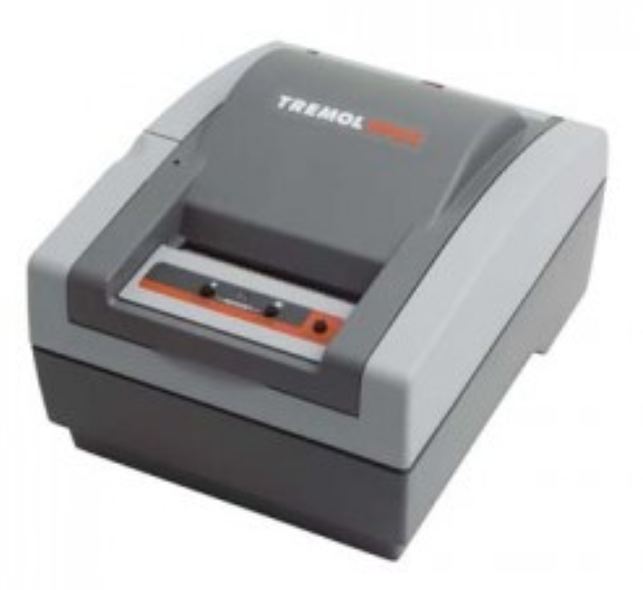
4. Key Use Cases (5/5) - KRA Compliance
KSPS has been developed to ensure KOKO’s operations are in compliance with KRA rules including:
Ensuring VAT is recorded and paid on the date that the customer deposits money into their account rather than when they purchase fuel and taking into account that deposits made for stove purchases are not subject to VAT
Having a tax script printed on each invoice - this has been accomplished by automating the printing of the KRA tax scripts by integrating Electronic signature devices (ESD) machines with the system
Automatically accounting for Withholding Tax on KOKO technology fees to Vivo
Automatically charging VAT on KOKOpoint rental income
Notes:
Explain opinions obtained from tax advisors re compliance
Complexity around the number of ESD machines required

Slide 12
5. Settlements and Payments
KSPS runs various payment schedulers at the end of the month that summarize amounts payable to:
Agents
KRA
The fuel wholesaler
The financing partner (TBC)
2. The schedulers run based on information generated by the automated transactions recorded throughout the month.
3. The Settlements Officer in the Finance team then downloads a file from Odoo (Bank upload file) and uploads this onto the banking platform, efficiently completing the bulk payments- successfully tested ability to manage 700 payment transactions (see appendix D)
A flawless and efficient financial settlement process = critical component of the experience / perceived value KOKO delivers to partners
(and therefore an area of risk…)
Notes:
Transactions have been recorded and the payments need to be made
Schedulers, bank accounts, bank upload file (screenshot of tested upload file for 700 payments)
Open question: Lack of automated last step settlement. Possibly integrate a third party

Slide 13
6. Open Questions
How do we treat consumer products pricing (stoves and fuels) differential across cities / markets?
How do we deal with local vs international fuel (DCCRF)?
What is the system’s role in the reordering process (capital efficiency, liquidity management and demand projections)?
How do we treat commissions (referrals) and other contractual values (agent terms, rental, floor earning) etc. across cities / markets?
How significantly will the business rules differ across cities / markets and hence require customisation specific to that city / market?
6. …?

Slide 14
APPENDICES

Slide 15
Appendix A: KSPS Performance Testing
Two iterations of performance testing in a simulated HL environment have been conducted to assess ability to handle transactions at scale and multiple transaction types simultaneously.
The tests demonstrated that the system could handle the minimum number of transactions expected in various workflows such as customer registration, KOKO cooker purchase and fulfilment, customer top ups and fuel purchases with a 99.8% job success rate of processing jobs already recorded in KOKO core.
This has informed the decision to have automatically scaling servers to handle more jobs as volumes increase and a review of the code to make it more efficient.
Next Steps in Testing
Testing while running different workflows simultaneously i.e. workflows from myKOKO and the KOKOpoints
Further code reviews by the engineering teams to seal any memory leaks. The engineering team to also identify any computationally intensive tasks so that the code can be refactored. This is in a bid to reduce memory & CPU utilization during load execution
Notes:
Failed jobs are logged by the system and subsequently passed. Reasons for failure in these specific tests were missing configuration of jobs in the ERP for negative top ups.
In addition to automated reports, the KSPS team also constantly reviews jobs to actively identify failed jobs

Slide 16
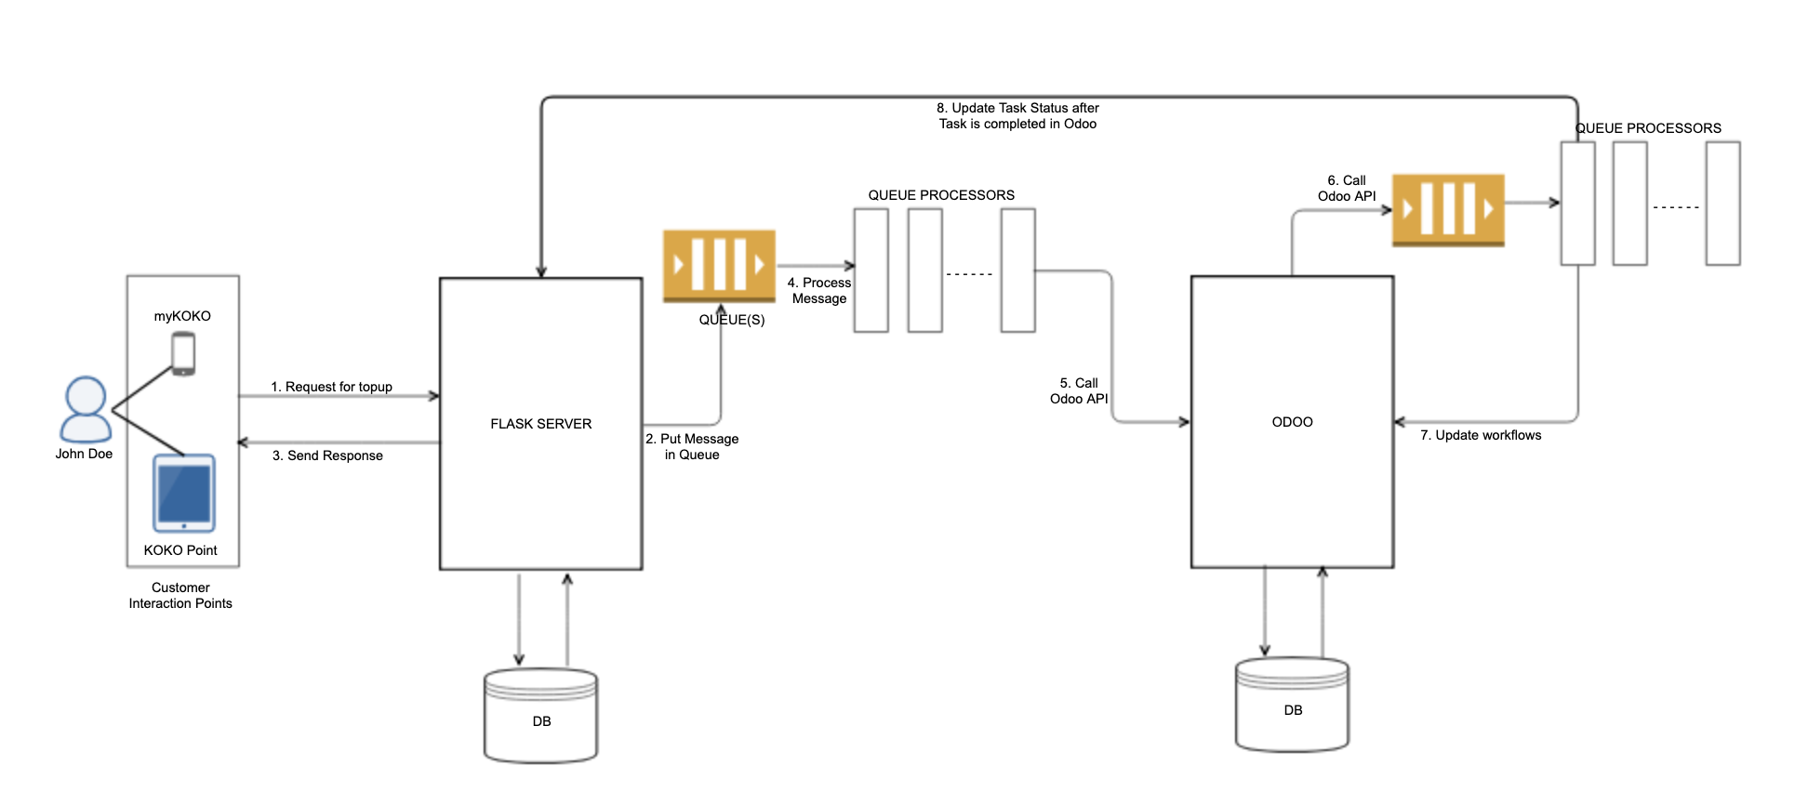
Appendix B: Software Design & Architecture (1/2)
KOKO Core updates to Odoo

Slide 17
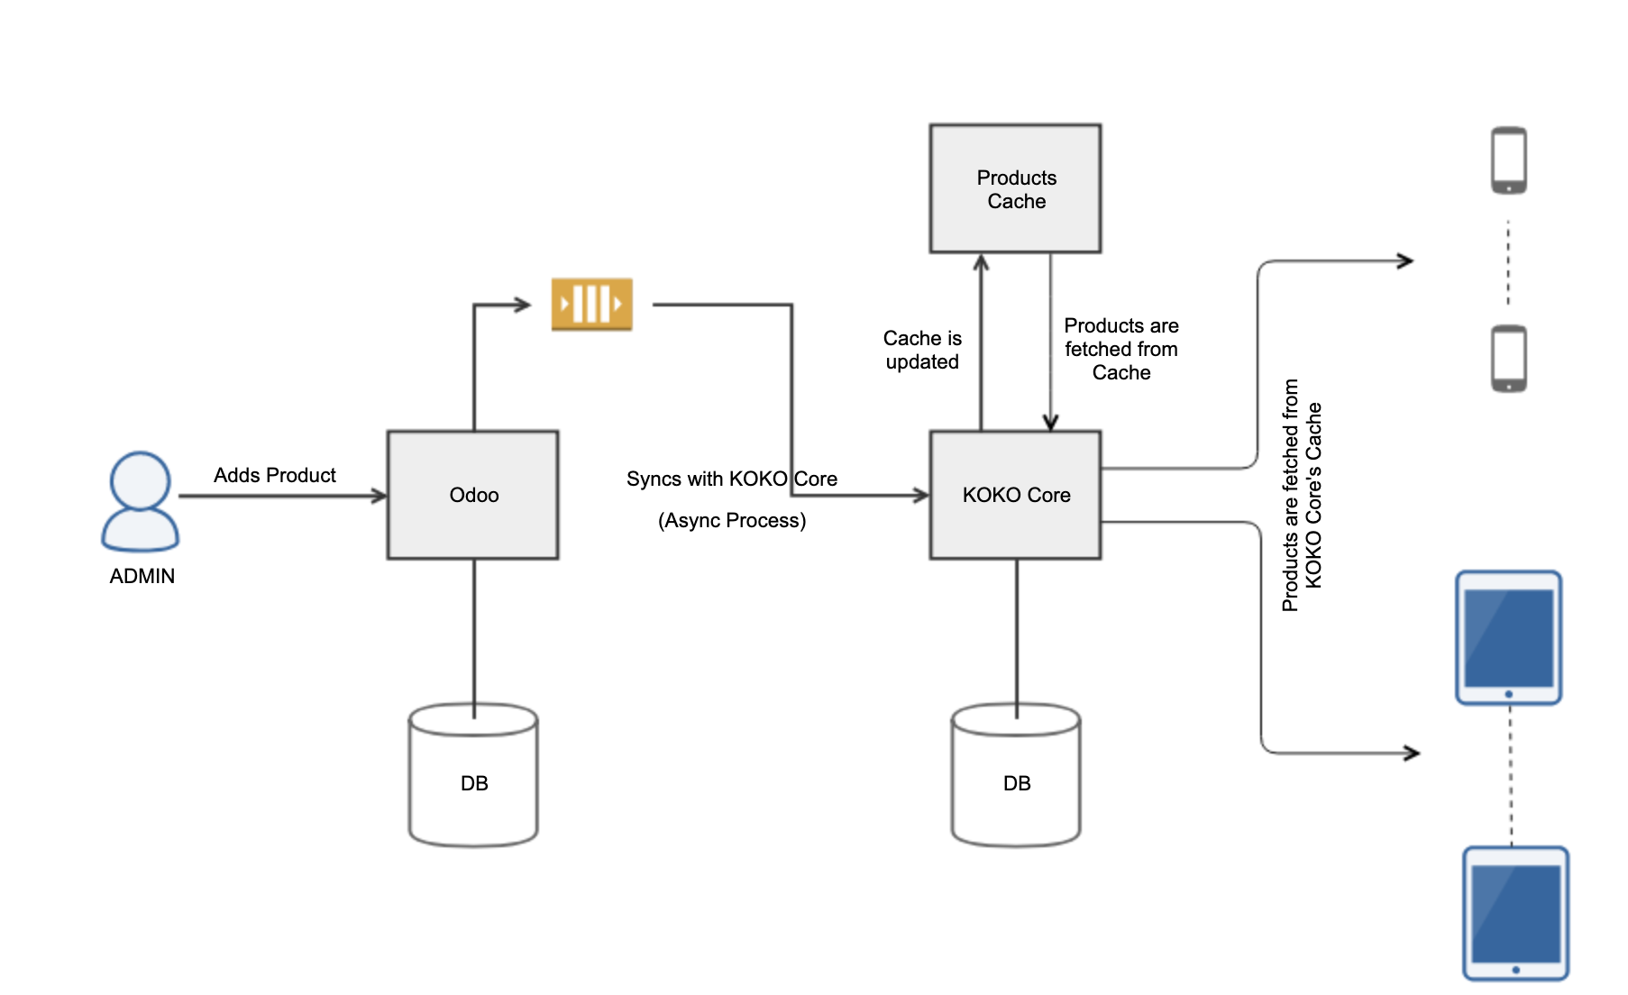
Appendix B: Software Design & Architecture (2/2)
Odoo updates to KOKO Core

Slide 18
Appendix C: Related Odoo Modules
KSPS has touchpoints and dependencies with a number of additional Odoo modules developed for KOKO, including:
KP Manufacturing / Assembly
KP / SDS / STS Maintenance
KOKO Distribution Management (Cost accounting)
Agent CRM
Contract management
Agent Contract Terms (KSPS)
KP Rental Calculations
KP Configurations
Saarus Accounting
Odoo - Tally integration
Cooker Kit Manufacturing
KNI - KNK Integration (Kit, Cooker and Canister Serial Numbers)
Procurement & Budget Control
Notes:
Highlight the need to use all modules. Can’t have parallel questions due to the dependencies

Slide 19
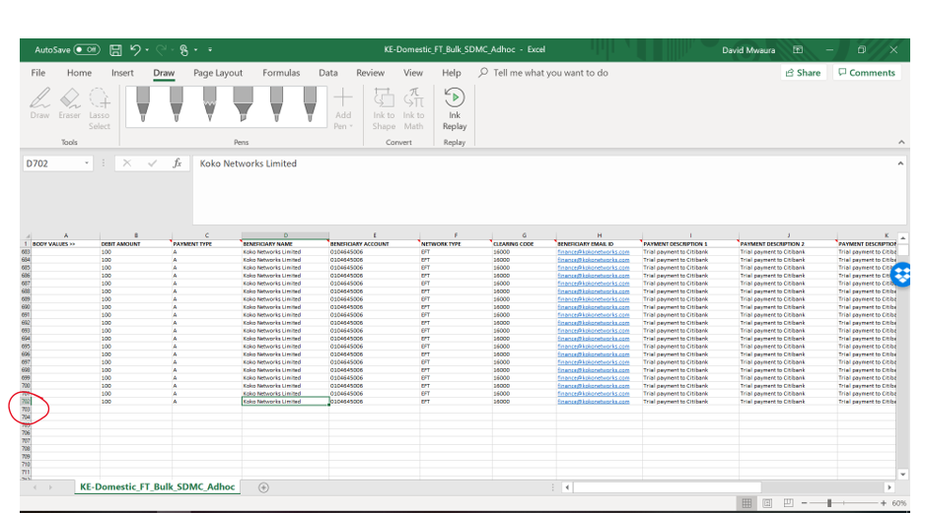
Appendix D: Bank Upload File
Extract of bank upload file used to test ability of CBA to make 700 bulk payments. Made 700 payments from KOKO CBA account to KOKO Citi account
Notes:
Highlight the need to use all modules. Can’t have parallel questions due to the dependencies

